Slide 1


The NBA 2020 Draft
By Dan Baumann and Sez Isguzar

Slide 2
Our Mission
The New Orleans Pelican’s 2019 Season in numbers
33 Wins and 49 Losses (League Rank 22/30)
116.8 points conceded per Game (League Rank 27/30)
A 9.1% decrease in blocks per game from the year before
A decrease in 3 point percentage throws from the year before
A League Rank of 19 for Personal Fouls
Why we are here:
We want to help your franchise reach the playoffs of the 2020 Season

Slide 3
How we can improve your team
4 Points of Action
We want to improve your team by:
1. Raising your 3 point shooting percentage
The modern game needs clinical 3 point shooters
2. Decreasing the team’s personal fouls count
Giving away too many fouls will make defenses weaker
3. Raising your free throw shooting percentage
Maximizes attacking output
4. Making your defense more robust with more blocks
Decrease the chance of your opponents scoring points
Our approach:
Using comprehensive statistics consisting of more than 1500 players we investigated these points of action
Our thorough analysis will allow us to prescribe the type of player the New Orleans Pelicans ought to buy in the NBA 2020 Draft

Slide 4
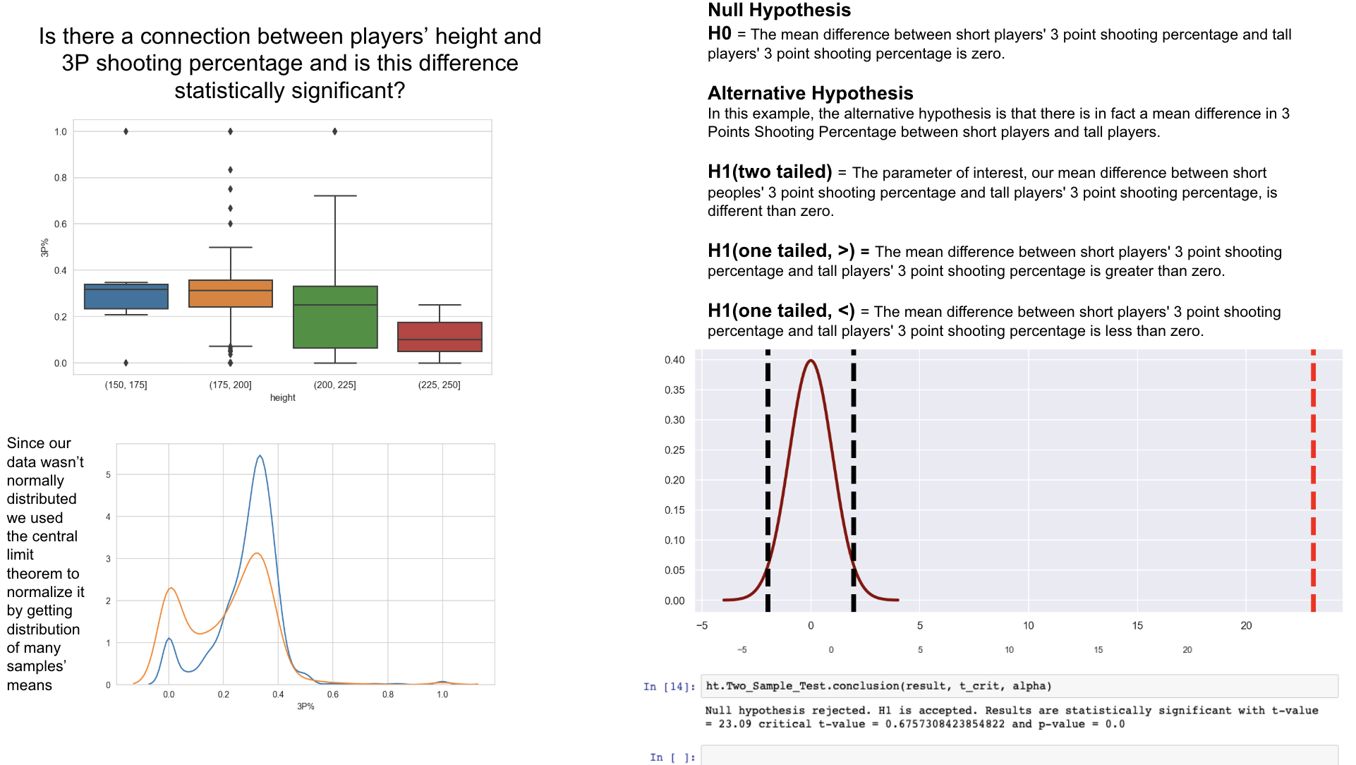
1) Raising 3 point percentage

Slide 5
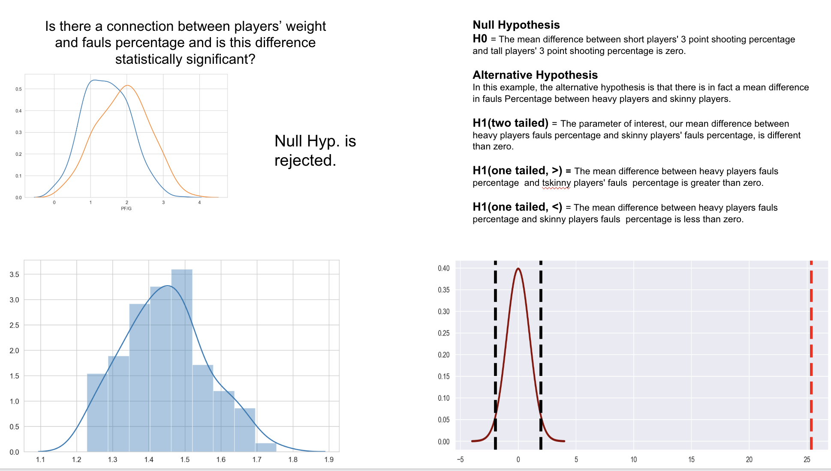
2) Decreasing personal fouls

Slide 6
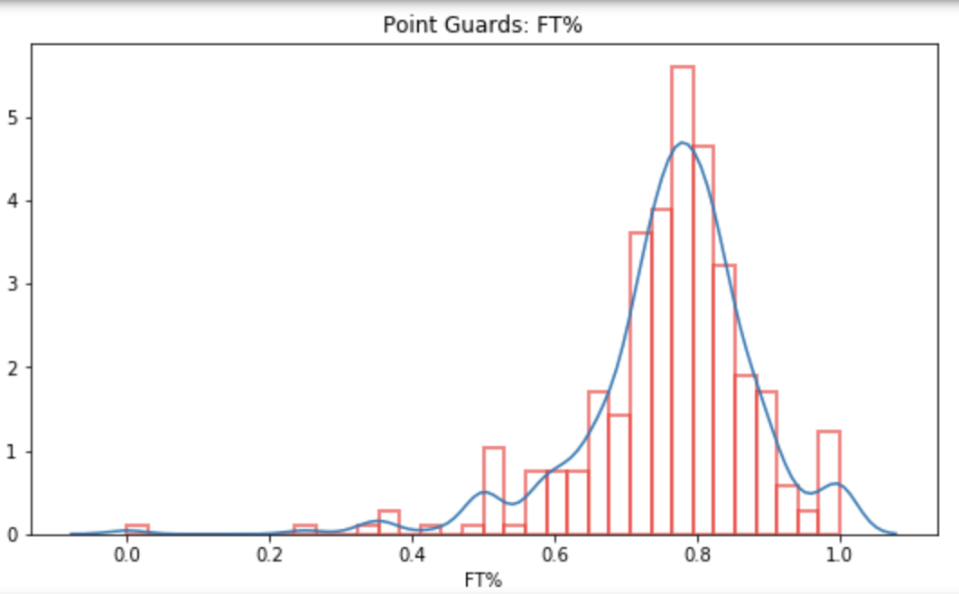
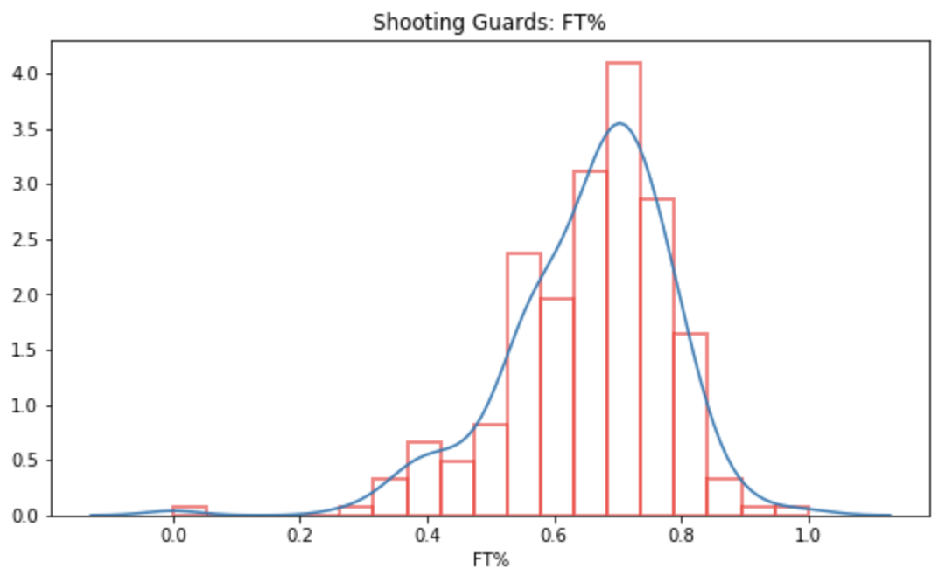
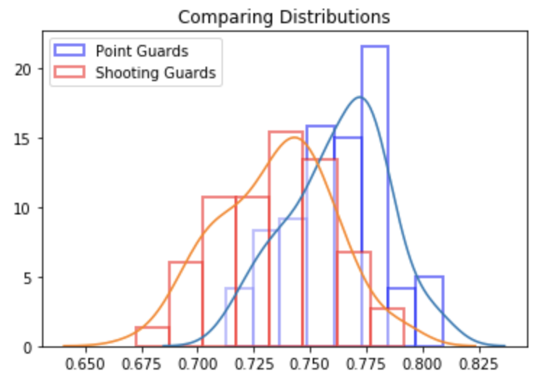
3) Raising your free throw percentage
An initial glimpse into the data
Point Guards vs. Shooting Guards
Our hypothesis more formally:
Null Hypothesis:
The average free throw shooting percentage for point guards is NO DIFFERENT to the shooting percentage of shooting guards
Alternative Hypothesis:
The average free throw shooting percentage for point guards is GREATER THAN the shooting percentage of shooting guards
Our sample distributions
Welch’s t-statistic | 8.28
p-value | Very small
t-critical value | 1.645
Conclusion | REJECT the Null Hypothesis

Slide 7
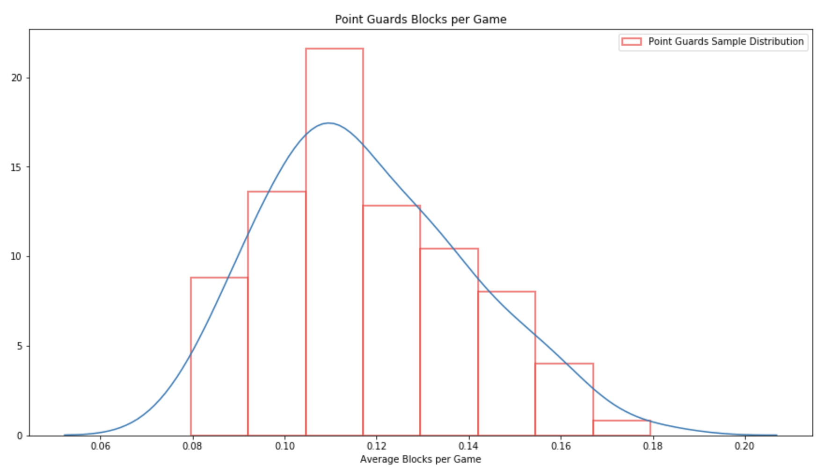
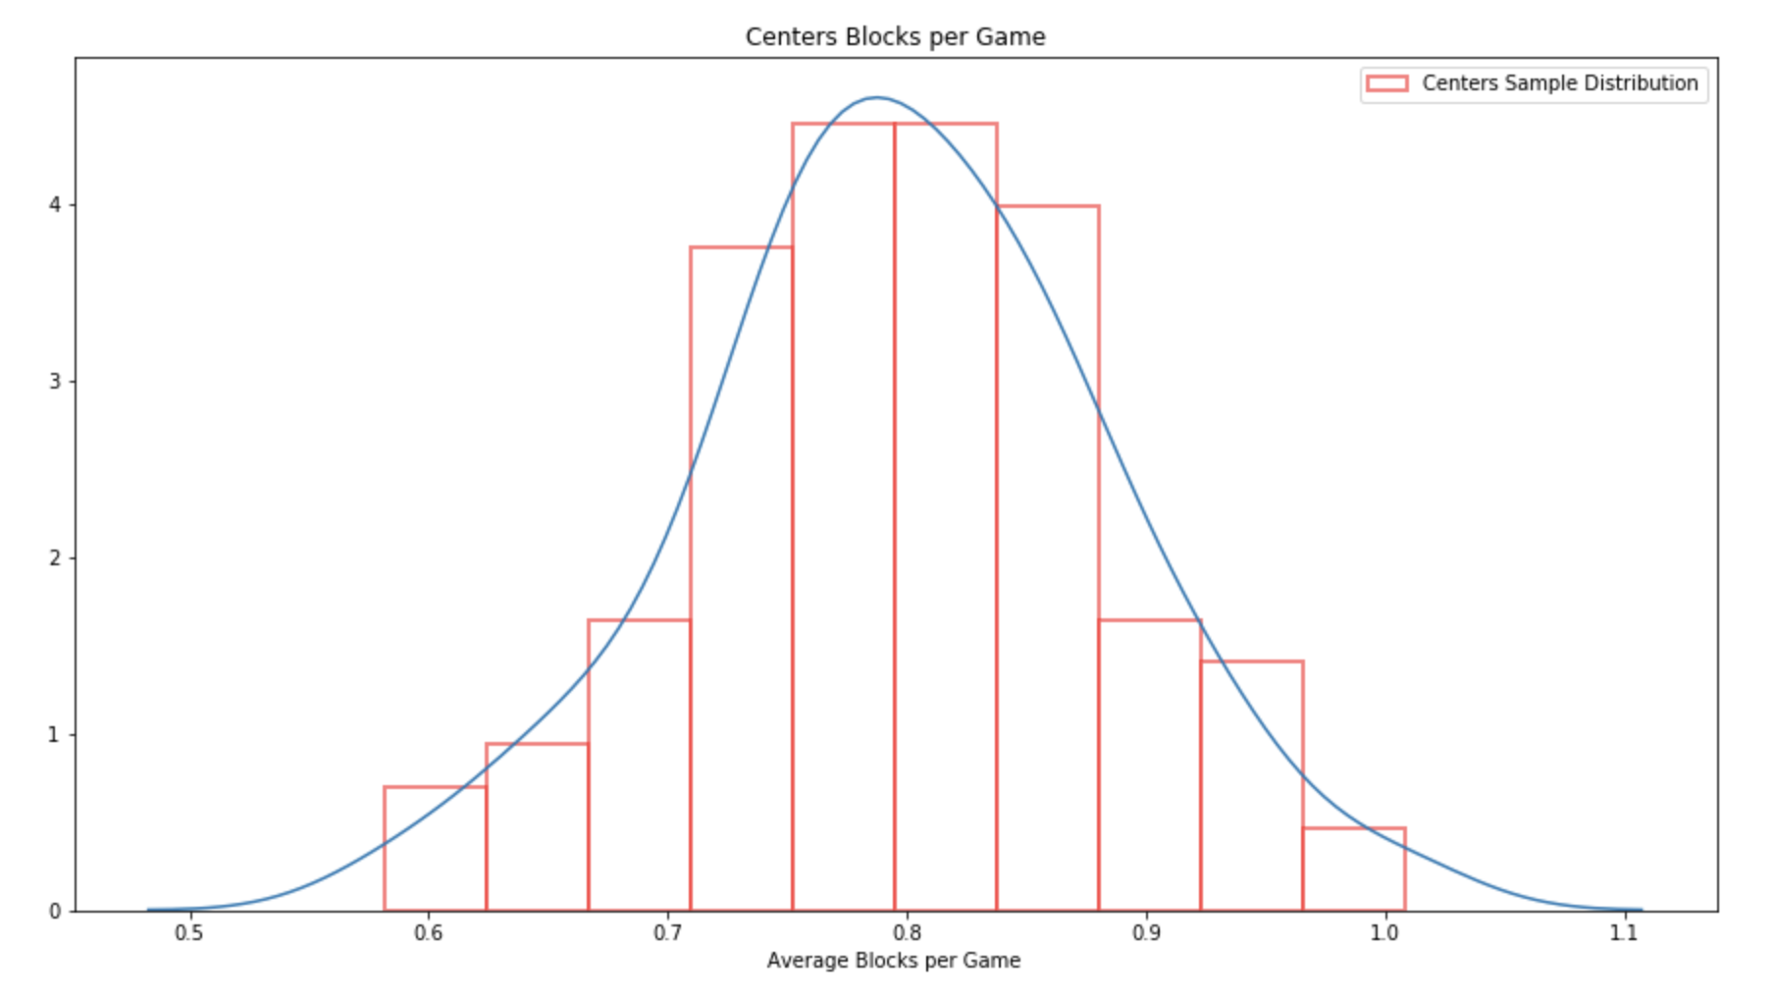
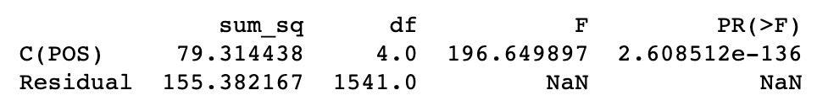
4) Raising your blocks per game
Blocks per game differ by positions
Using another statistical method called ANOVA, we can compare the differences in blocks per game across all the different positions on a basketball court
Our hypothesis more formally:
Null Hypothesis:
Across different positions, there is NO DIFFERENCE in blocks per game
Alternative Hypothesis:
Across different positions, there are certain positions which have GREATER blocks per game
ANOVA Analysis
REJECT THE NULL!!
A pair-wise t-test between point guards and centers allows us to conclude that centers are better at blocking!!

Slide 8
Concluding remarks
Draft point guards over shooting guards to increase free throw percentage
Draft centers to improve blocks per game
Draft shorter players to improve 3 point percentage
Draft lighter people to avoid more fouling

Slide 9
SAFE
Q&A

